Slide 1






INFO 4907
EXPLORATORY DATA ANALYSIS:
Advancing Healthcare Through AI And
Machine Learning Incorporations
By Samantha Minchew

Slide 2

“Artificial intelligence is helping revolutionize healthcare as we know it.”
INTRODUCTION
Using personalized medicine in contrast to the traditional one-size-fits all approach emphasizes growing recognition that individuals respond differently to treatments based on their unique genetic makeup, lifestyle, and medical history

Slide 3




SIGNIFICANCE OF PERSONALIZED MEDICINE
“AI-powered solutions can help prioritize which locations will be greatly impacted to quickly respond to risk factors that may otherwise affect the ability to deliver products to people who count on them.”
How does the adoption of AI in healthcare impact patient outcomes and overall quality of care?
What role does AI play in improving accuracy and reducing errors in medical diagnosis?
What are some political/social biases provided by Doctors and how does AI help?

Slide 4

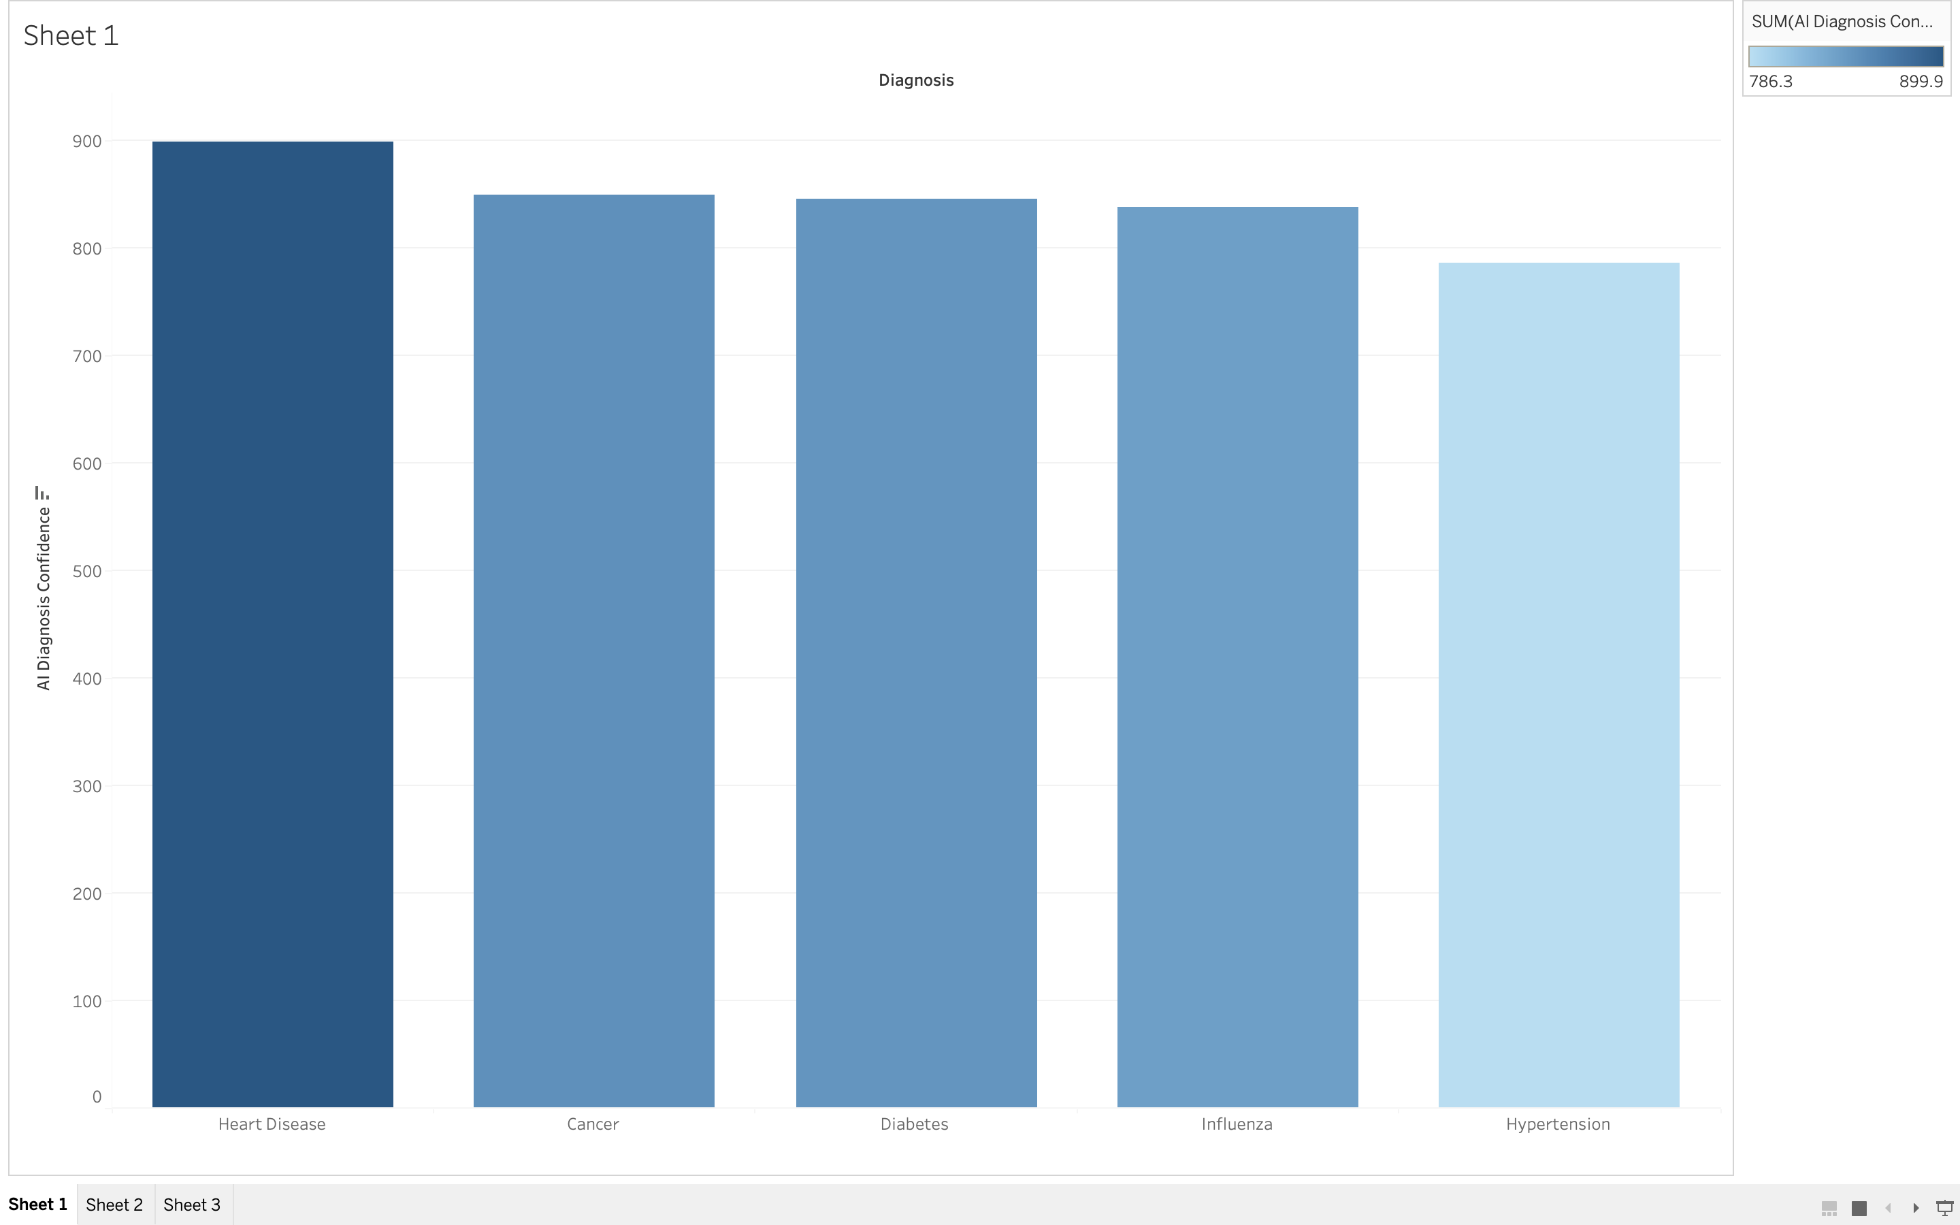

The adoption of AI in healthcare has the potential to significantly improve patient outcomes and overall quality care. AI technologies can enhance diagnostics accuracy, identify patterns in patient data, and assist in personalized treatment plans..

Slide 5
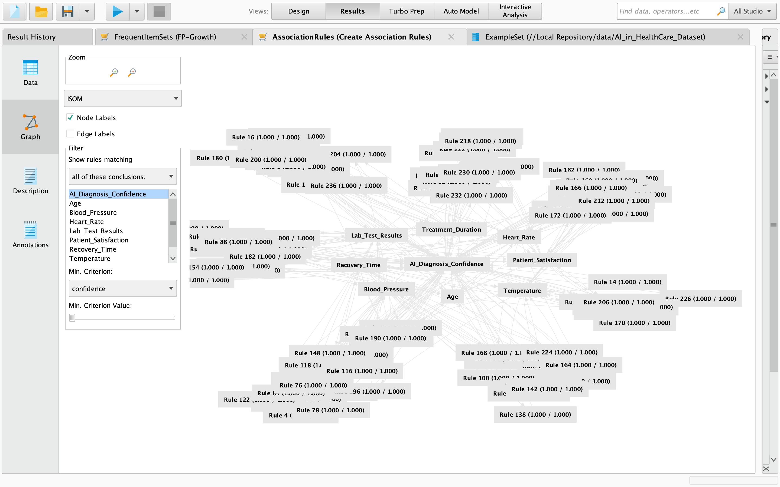
AI plays a crucial role in improving accuracy and reducing errors in medical diagnosis by leveraging advanced algorithms and machine learning. AI systems can analyze vast amounts of medical data, including images, patient records, and clinical notes, with speed and precision beyond human capacity. This aids in early detection of diseases, provides more accurate diagnostic insights, and helps healthcare professionals make informed decisions.
Through pattern recognition and data analysis, AI can identify subtle indicators that may escape human notice. Moreover, AI can assist in minimizing errors associated with subjective interpretations, ensuring a more standardized and consistent diagnostic process. While AI has the potential to enhance diagnostic capabilities, it's important for healthcare professionals to collaborate with these systems, as a combination of human expertise and AI-driven insights often yields the most reliable results.

Slide 6

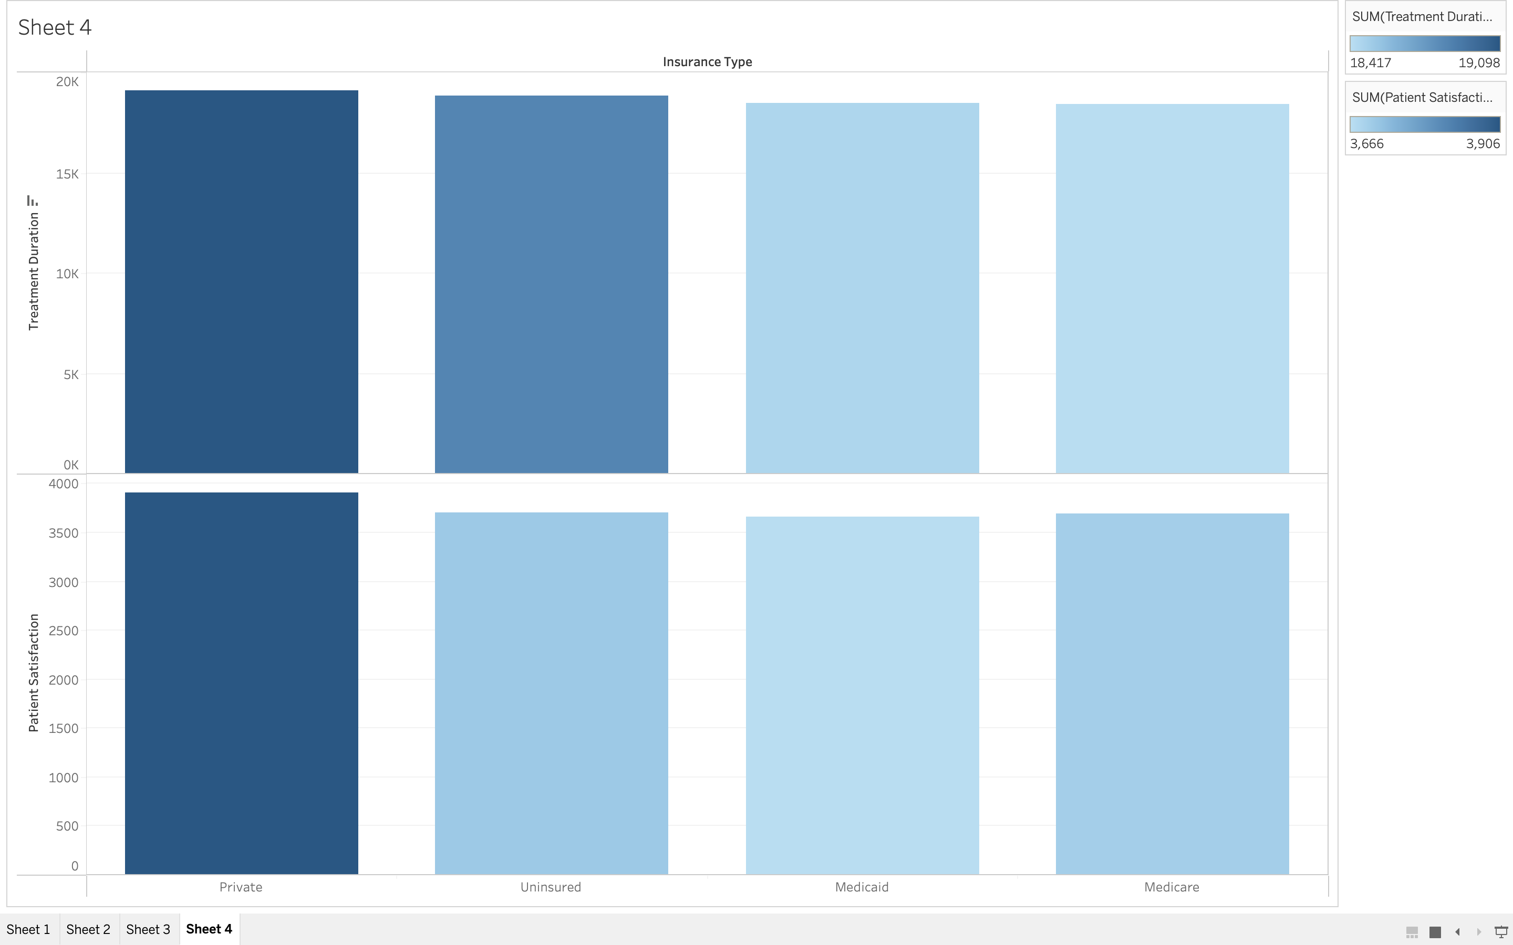

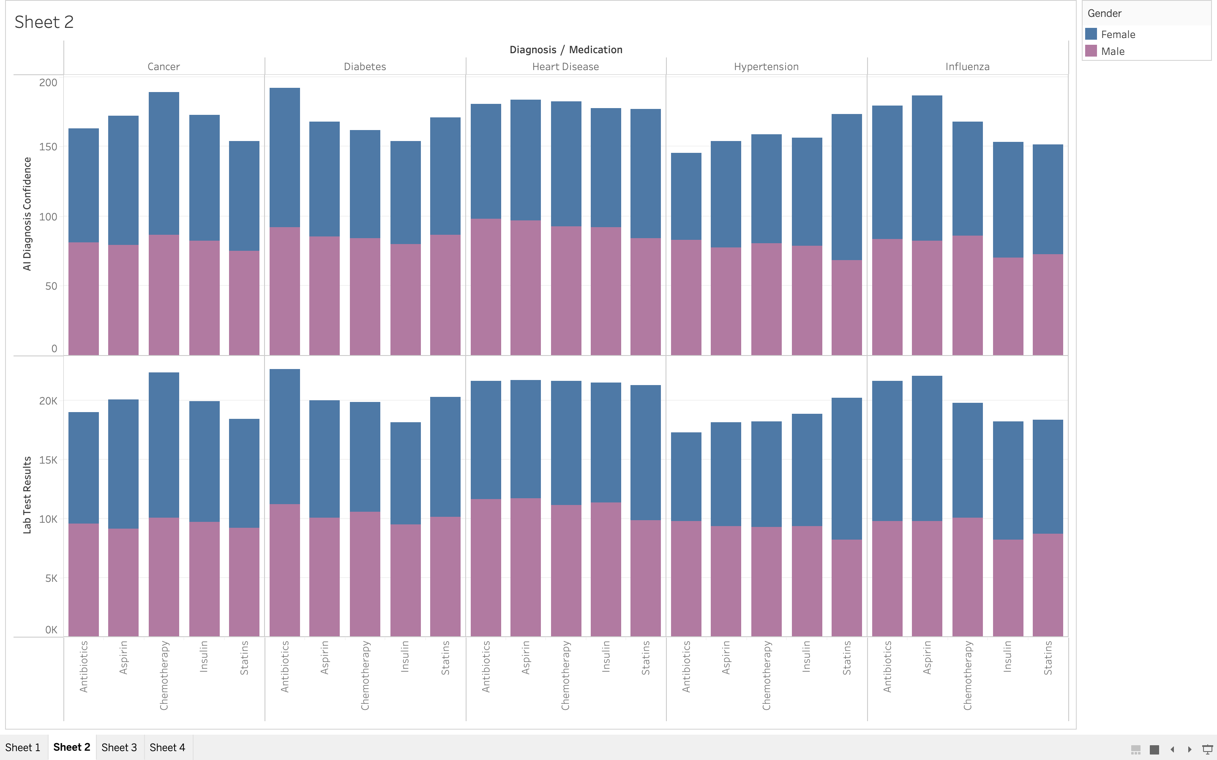
Per person personal health care spending for the 65 and older population was $22,356 in 2020, over 5 times higher than spending per child ($4,217) and almost 2.5 times the spending per working-age person ($9,154).
Older Adults (aged 65 and older) were the smallest population group, about 17 percent of the population, and accounted for approximately 37 percent of all spending in 2020.
The same can be said for

Slide 7
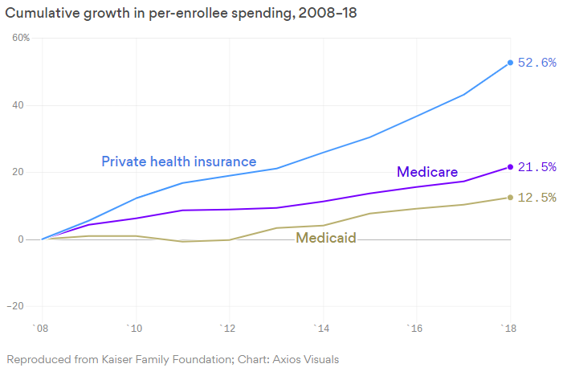
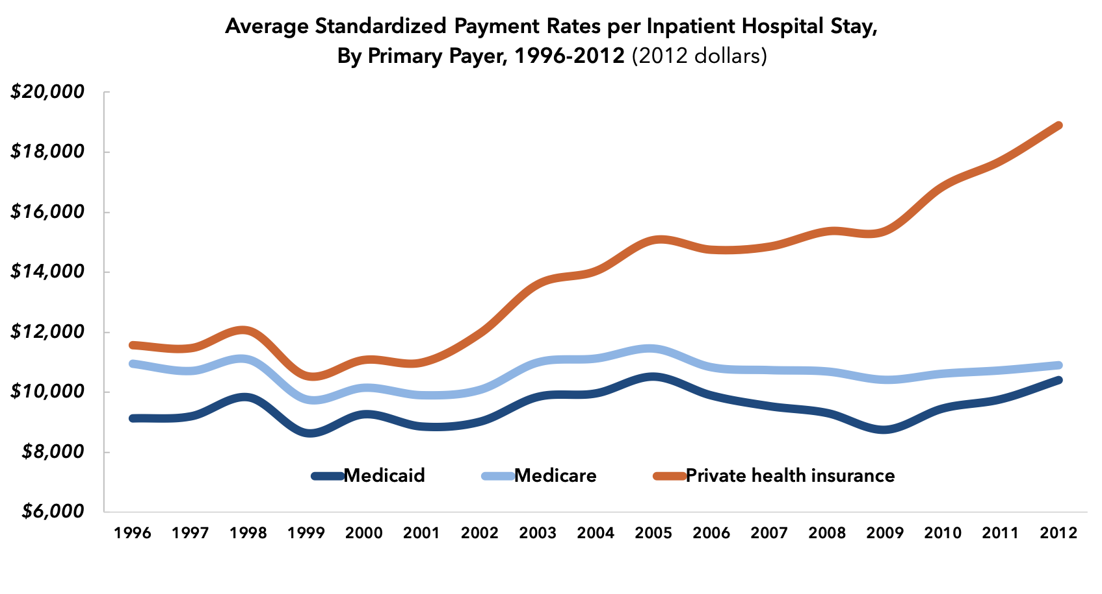
There are concerns about potential biases and disparities in healthcare, where some hospitals and doctors may inadvertently favor patients with private insurance over those with Medicaid.

Slide 8




01
Data Science and AI can have a significant impact is in the accuracy of medical diagnosis. By analyzing patient data, including medical histories, test results, and other relevant data points, AI tools can identify patterns and predict potential outcomes with a high degree of accuracy.
AI can help providers gather that information, store and analyze it, and provide data-driven insights from vast numbers of people. Leveraging this information can help healthcare professionals determine how to better treat and manage diseases. Organizations are also starting to use AI to help improve drug safety.
02
In summary, applying AI in healthcare analytics revolutionizes diagnostics, treatment, and operational efficiency, leading to personalized care, improved patient outcomes, and the potential for groundbreaking advancements in medical research and practice. The ethical application and adherence to regulations are essential for building trust ad ensuring the responsible use of ai in healthcare.
03

Slide 9

01
02
03
04

Slide 10



PROJECT OBJECTIVES
AI could be used to increase efficiency in healthcare diagnoses. According to Harvard's School of Public Health, although it's early days for this use, using AI to make diagnoses may reduce treatment costs by up to 50% and improve health outcomes by 40%. Overall, the primary aim of health-related AI applications is to analyze relationships between clinical data and patient outcomes.
OBJECTIVE 01:
OBJECTIVE 02:
OBJECTIVE 03:
Improve Medication Adherence
Predict Disease Outbreak
Drug Discovery Acceleration
The objective of this improvement would be collected by implementing an AI-driven system to enhance medication adherence by developing a personalized reminder and education platform for patients, considering individua health data and preferences.
Developing a predictive analytics model using AI to forecast and monitor the outbreak of infectious diseases, enabling times for public health interventions and resource planning.
Utilizing AI algorithms to analyze large datasets for drug discovery, predicting potential candidates, optimizing molecular structures, and expedition the drug development process for specific medical conditions.

Slide 11






METHODOLOGY
Addresses Complexity & Interdependence
Healthcare AI projects are often complex and involve various interdependencies. A methodology provides a roadmap to navigate this complexity, ensuring that all components are considered and integrated effectively.
Continuous Improvement
Methodology allows for continuos improvement by enabling feedback loops. After deployment, insights gained from real-world use can be used to refine and enhance the AI system, addressing any shortcomings or evolving healthcare needs
Guides Systematic Development
Methodology of AI solutions, from defining objectives to model deployment. It ensures that each phase of the project is approached in a logical and organized manner.
Facilitates Ethical Considerations
Methodology helps incorporate ethical considerations into the AI development process. It prompts researchers to address issues like bias, privacy, and fairness, ensuring responsible and ethical use of AI in healthcare.

Slide 12
THANK YOU!

Slide 13
REFERENCES
Blanco-González, Alexandre, et al. “The Role of AI in Drug Discovery: Challenges, Opportunities, and Strategies.” Pharmaceuticals (Basel, Switzerland), U.S. National Library of Medicine, 18 June 2023, www.ncbi.nlm.nih.gov/pmc/articles/PMC10302890/#:~:tex t=One%20of%20the%20key%20applications,compound%2 0on%20the%20human%20body.
Education, IBM. “The Benefits of AI in Healthcare.” IBM Blog, 3 Oct. 2023, www.ibm.com/blog/the-benefits-of-ai-in-healthcare/#.
JohnsonA, Welch. “Artificial Intelligence.” Artificial Intelligence in Healthcare Analytics, Johnson & Johnson, 2021, www.jnj.com/innovation/artificial-intelligence-in- healthcare?&utm_source=google&utm_medium=cpc& utm_campaign=GO-USA-ENG-PS-Corporate+Equity-GP-PH- RN-NB_STORIES_ARTIFICIAL+INTELLIGENCE&utm_content=AI - +Machine+Learning&utm_term=machine+learning+and +health+care&gclid=Cj0KCQiA67CrBhC1ARIsACKAa8S3Mf WGQ09RXoJNp2Y6_p1CQJhikacJfyVTEuhRYZS_9w0bezm _u0gaAkKeEALw_wcB&gclsrc=aw.ds.
Radanliev, Petar, et al. “Methodology for Integrating Artificial Intelligence in Healthcare Systems: Learning from Covid- 19 to Prepare for Disease X.” AI and Ethics, U.S. National Library of Medicine, 2022, www.ncbi.nlm.nih.gov/pmc/articles/PMC8525053/.
Wilson, Karen. “Contextualizing Artificial Intelligence for Heor in 2023.” Avalere, 17 Nov. 2023, avalere.com/insights/contextualizing-artificial-I ntelligence-for- heor-I 2023#:~:text=AI%20achieves%20better%20diagnostic%20 performance,wait%20times%20and%20increase%20precision.

